Slide 1











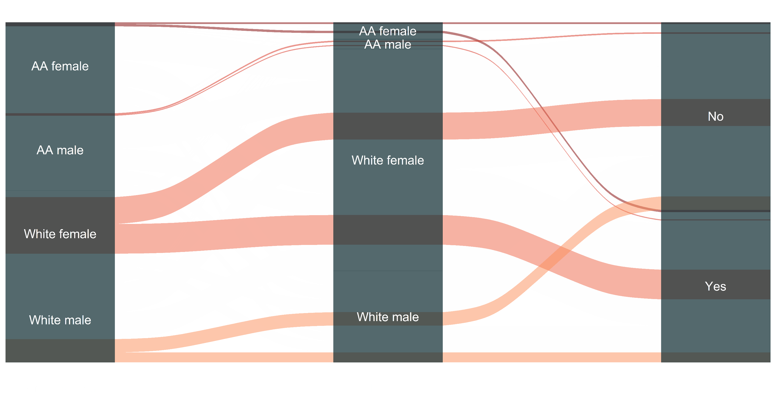




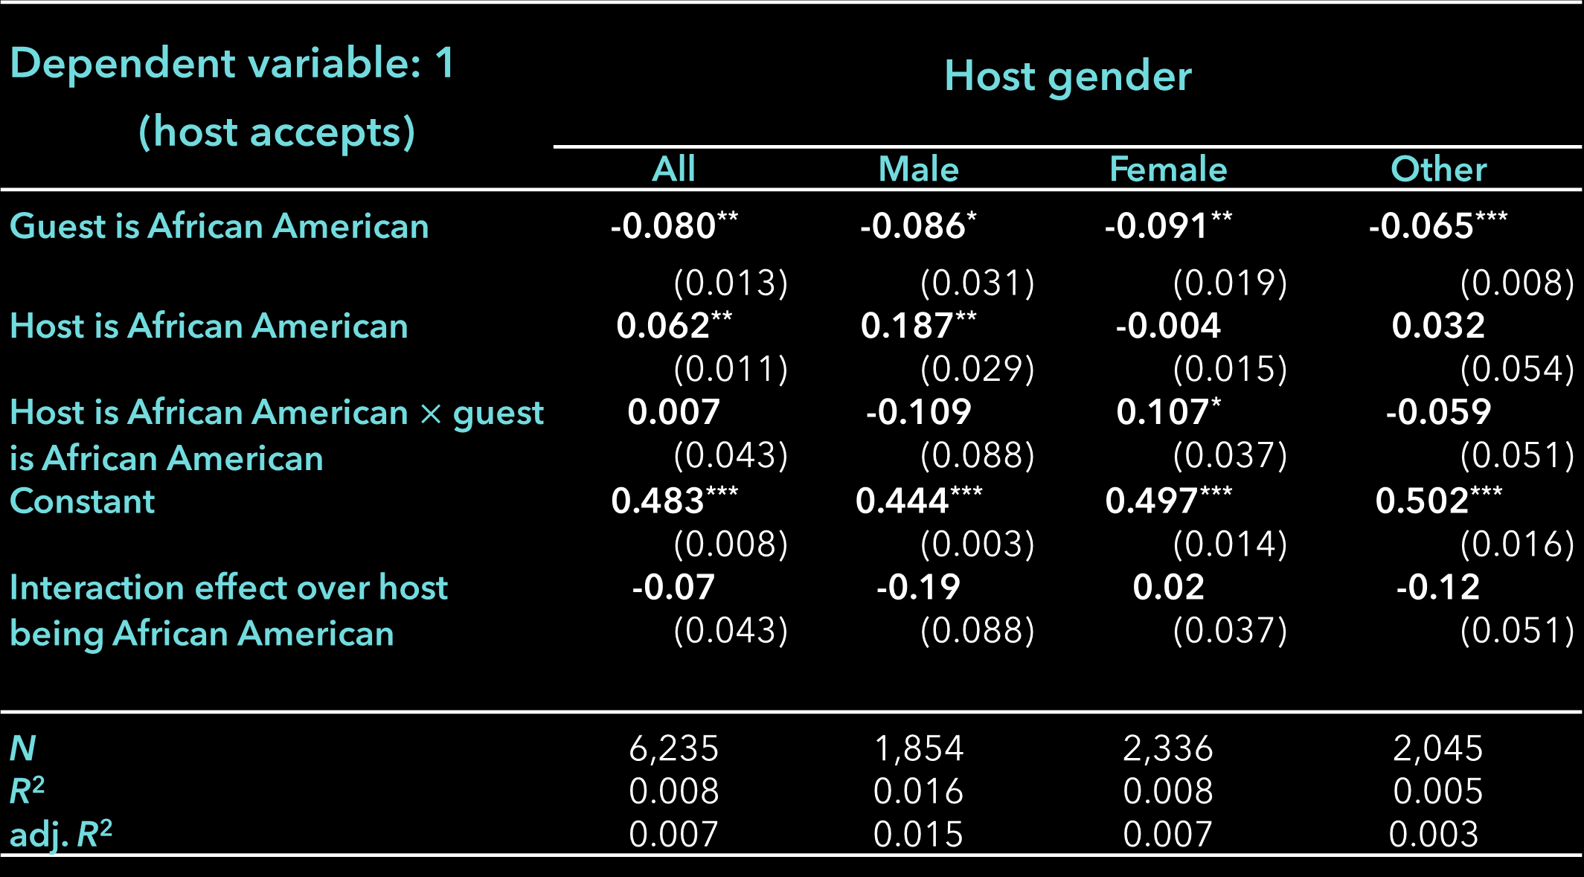
Racial Discrimination in the Sharing Economy: Evidence from a Field Experiment
The disruptive role of sharing economies within previously regulated areas of economic life has brought considerable interest in the characteristics of these new market structures. Nevertheless, little emphasis has been placed on understanding the dynamics of discrimination in them. To face this issue, B. Edelman et al. (2017) use a quasi-experimental approach, grounded on web scrapping, to identify racial based discrimination in the rental market of Airbnb.
⭐ Quasi experimental design: all things equal, except names
II) Discrimination conditional on listing characteristics
Available listing
General Hypotesis
The study’s identification strategy was grounded on the intuition that, given guest-host paring randomization, if requests from black guests are, on average, rejected more than those of white guests with all other features equal except the implied race in their account name, then, there could be evidence for is racial discrimination in the hosts' decisions to rent.
.8
Discrimination was still found when controlling for listings and census features. Race interactions with price indicators are linked to a statistically significant 7-percentage point decline in the acceptance probability for black rental requests.
.6
.4
Guest message to host
Effective rental or rejection
Linear acceptance prediction
=
.2
Guest is AA
T1 White female
T2 AA female
T3 White male
T4 AA* male
0
Guest is white
Random guest
allocation
Host evaluates offer
(T1 T3)
- (T2 T4)
discrimination
1
2
3
4
5
6
7
8
9
10
11
ln(Price)
Discrimination was also statistically significant when accounting for the physical characteristics of the listing and its geo-referenced ethnic composition: keeping the listings census track constant, requests from black guests are, on average, rejected by over 8 pp more relative to that of white individuals.
There was a general absence of homophily when studying acceptance rates in gender-race groups, as only black women reported high effective rental responses over request from other black women. Surprisingly, homophily is not present male in African American hosts, who reported an acceptance gap of 25 pp favouring white retentive to black guests.
Racial discrimination is persistent in the Airbnb market
III) Homophily and discrimination
The general results of the experiment show a disproportion in the rate of effective rentals between black and white guests; with a positive response rate of 48,78% white guests positive response rate are 7,96 pp** higher than those of black guests. That is, a 16% differential in acceptance rates against African Americans.
16%
Acceptance rate on race and sex
The discrimination gap against African American was studied in three areas I) the demographics of the host, II) the characteristics of the property and rent listing, and III) the race-gender homophily levels between host and guest.
Same gender-race allocations only account for 1.92% of all host-guest pairs in the rental request flow.
I) Discrimination conditional on host characteristics
Dependent variable: 1 (host accepts) | Host gender
 | All | Male | Female | Other
Guest is African American | -0.080** | -0.086* | -0.091** | -0.065***
 | (0.013) | (0.031) | (0.019) | (0.008)
Host is African American | 0.062** | 0.187** | -0.004 | 0.032
 | (0.011) | (0.029) | (0.015) | (0.054)
Host is African American $×$ guest is African American | 0.007 | -0.109 | 0.107* | -0.059
 | (0.043) | (0.088) | (0.037) | (0.051)
Constant | 0.483*** | 0.444*** | 0.497*** | 0.502***
 | (0.008) | (0.003) | (0.014) | (0.016)
Interaction effect over host being African American | -0.07 | -0.19 | 0.02 | -0.12
 | (0.043) | (0.088) | (0.037) | (0.051)
N | 6,235 | 1,854 | 2,336 | 2,045
R² | 0.008 | 0.016 | 0.008 | 0.005
adj. R² | 0.007 | 0.015 | 0.007 | 0.003
Request flow on race and gender
Female AA
Male AA
Male white
Female white
No homophily
Racial discrimination is statistically significant even when accounting for same race interactions between host and guest.
⭐ Critique and extension
I) Internal validity
II) External validity
Black guests reported rejection rates of 52.89% and 59.72% from black and white guest respectively, while rejection for white individuals was 45.53% and 51.70%.
The low number of same-race gender interactions between host and guests excludes relevant cofounders of intragroup and intergroup discrimination that have proven relevant in areas such as education and the labor market.
Control variables classification from third parties may also create measurement errors biasing the estimated discrimination gap.
The considerable frequency of listings from Los Angeles and Washington, and the relative noise in the inferred discrimination effects, suggests that the identified effect may be only locally sound, and susceptible to hedonic characteristics of the cities.
Marginal effects of race on acceptance rate
.6
Guest is AA
In the male host subsample the overall effect increases up to 11pp, yet the effect is no longer statistically relevant.
.55
Guest is white
.5
The female subsample reports a positive effect of race interactions as female black host tend to accept black guest request 2pp relative to white guest.
III) Extension
Linear Prediction for request acceptance
Estimations should be performed to test the discrimination gap robustness using multiple sampling mechanisms.
Further research should identify diverse race and gender-based host sampling frames where the auditing experiments can be developed under full methodological disclosure and explicit population sampling.
.45
Sampling decisions, shaping the scrappers’ queries, should also be supported by experimental procedures, like stratified sampling, to better access hosts’ geographic and racial distribution and listings.
.4
.35
Host is white
Host is AA
In general there are larger acceptance rates for white guests regardless of the host's race.
Replication codes, anonymised data tables, and graphs available at GitHub.
* AA. African American.
**pp. Percentual points.
Replication from Edelman, B., Luca, M., & Svirsky, D. (2017). Racial Discrimination in the Sharing Economy: Evidence from a Field Experiment. American Economic Journal: Applied Economics, 9(2), 1–22. https://doi.org/10.1257/app.20160213

